Slide 1
29 November ground school
CI Jadon Tsai

Slide 2
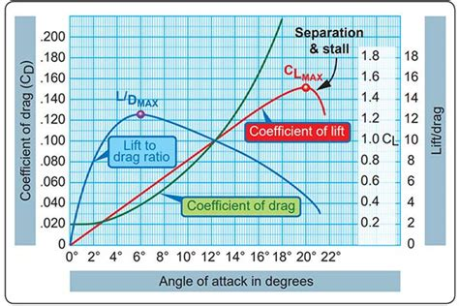
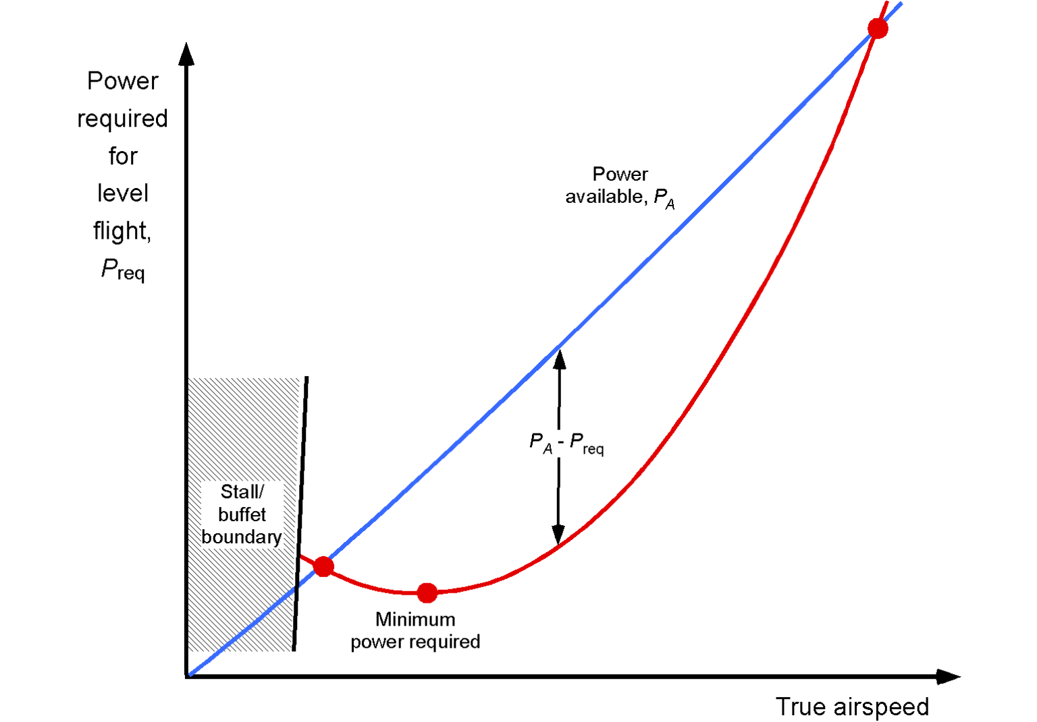
Power curves
“region of reverse command”
Density altitude – affects engines (humidity – water is not oxygen)

Slide 3
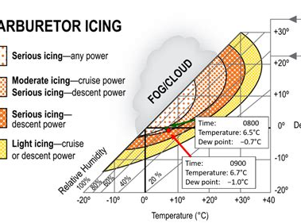
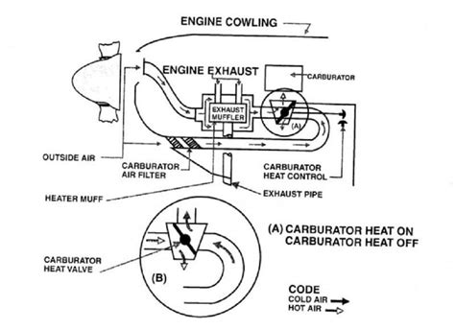
Carb heat
When you reduce power
Does not have to be cold outside

Slide 4
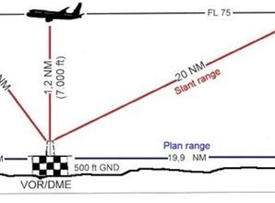
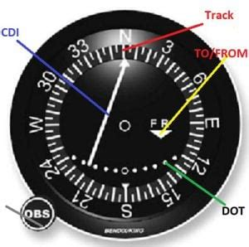
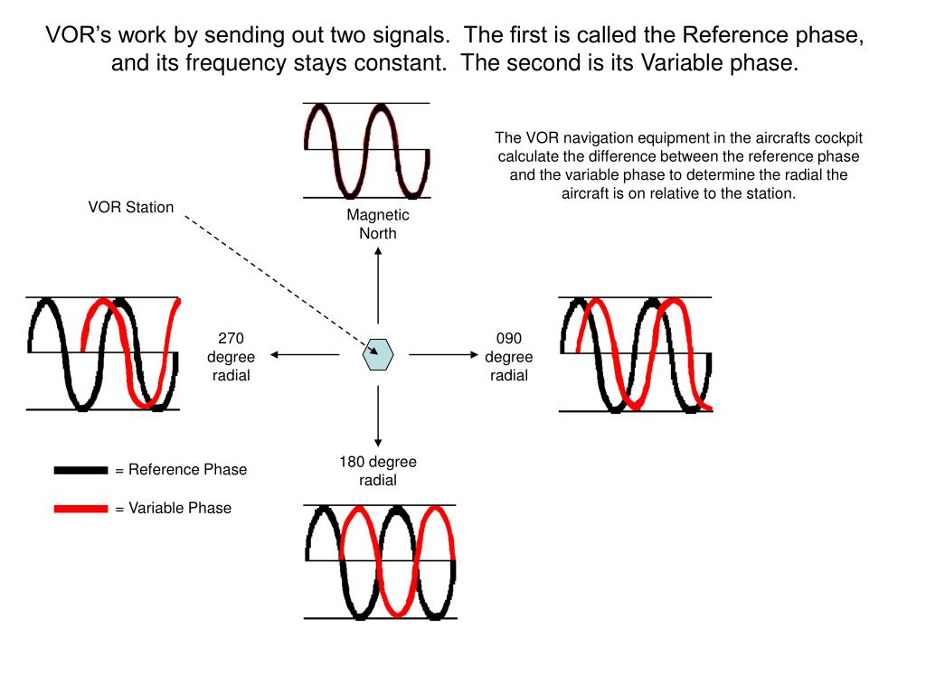
RNAV
VORs aren’t actually used anymore, but you’re expected to know how to use them

Slide 5
Radio license
Will make an announcement, but if you want a ROC-A, can arrange
Study guide posted in channel

Slide 6
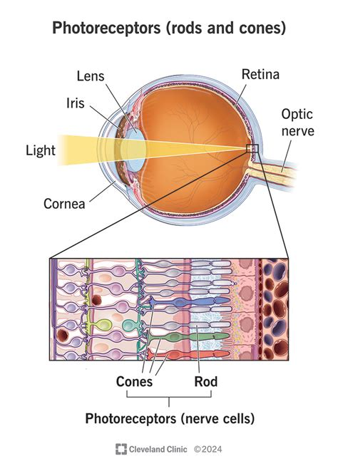

Human factors

Slide 7
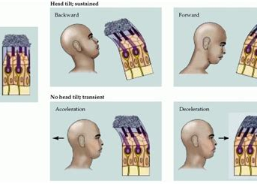
Cont’d
Hypoxia is the OPPOSITE of hyperventilation
Hypoxic, Anemic, Stagnant, HIstotoxic

Slide 8
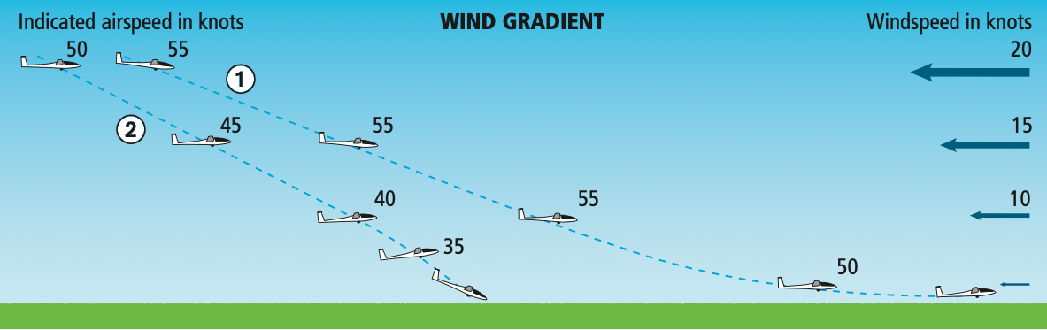
Wind gradients

Slide 9
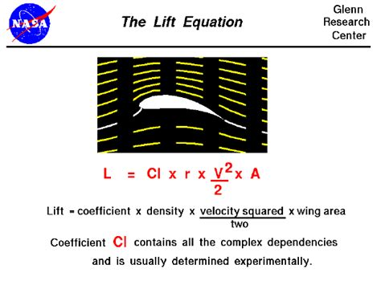
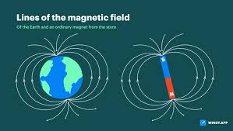

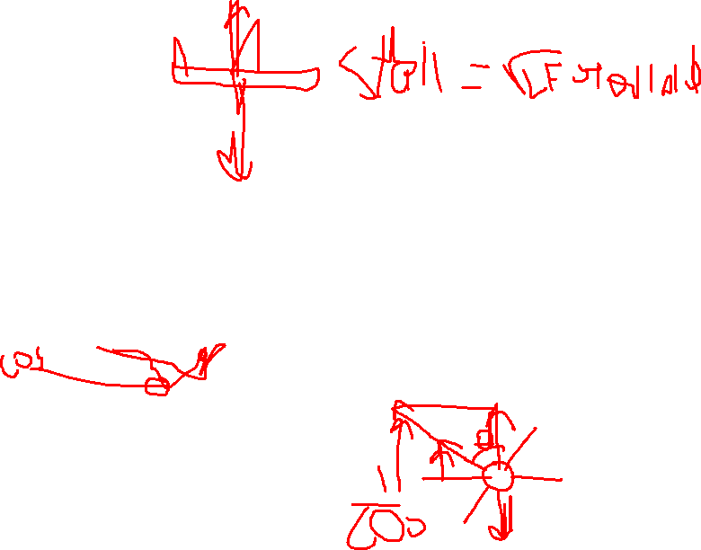
Other

